Slide 1

Discount Audio & Spares
BMZ IT SOLUTIONS

Slide 2
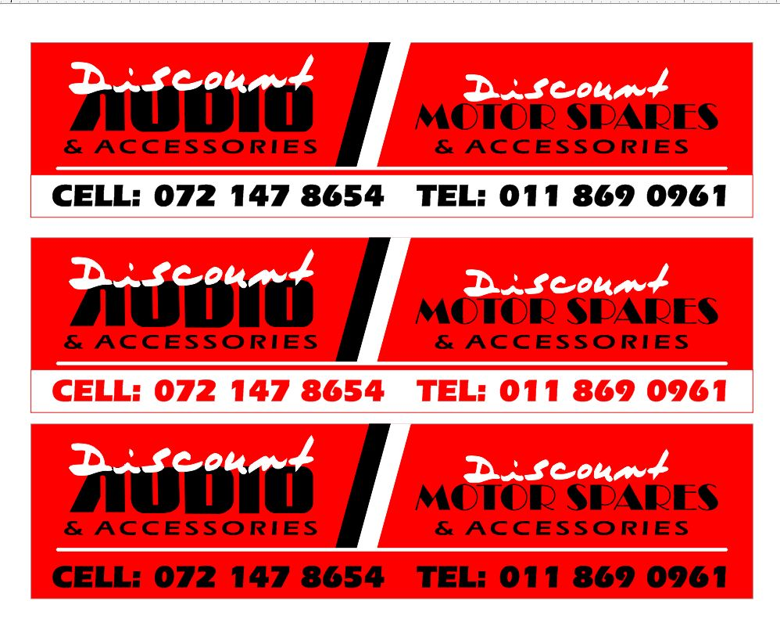
Ice breaker!
What do you say to a frog who needs a ride?
HOP IN!

Slide 3

Problem Domain (System Analysis)
Discount Audio and Motors Spares is a newly established business that offers and provides services related to vehicles. Since the business was just established two months ago, it does not have a huge clientele and so it needs to attract new customers to sell its vehicle audio products, accessories, alarm systems, motor spares, etc. at an affordable price. Another problem the business is facing is that the shop is currently located in Alberton. This becomes a problem due to the distance certain customers travel to get to the shop location. The app and website will not only help customers shop for car parts and be able to book various vehicle services online but also attract a new clientele from all around the country.

Slide 4

Project Purpose
currently Audio and Motors Spares offer and provide services related to vehicles. The store offers vehicle audio products, accessories, alarm systems, motor spares etc. at an affordable price. The shop is in Alberton, and this becomes a problem due to the distance from certain customers and the shop location. The app and website should help customers shop for car parts and be able to book various vehicle services online

Slide 5
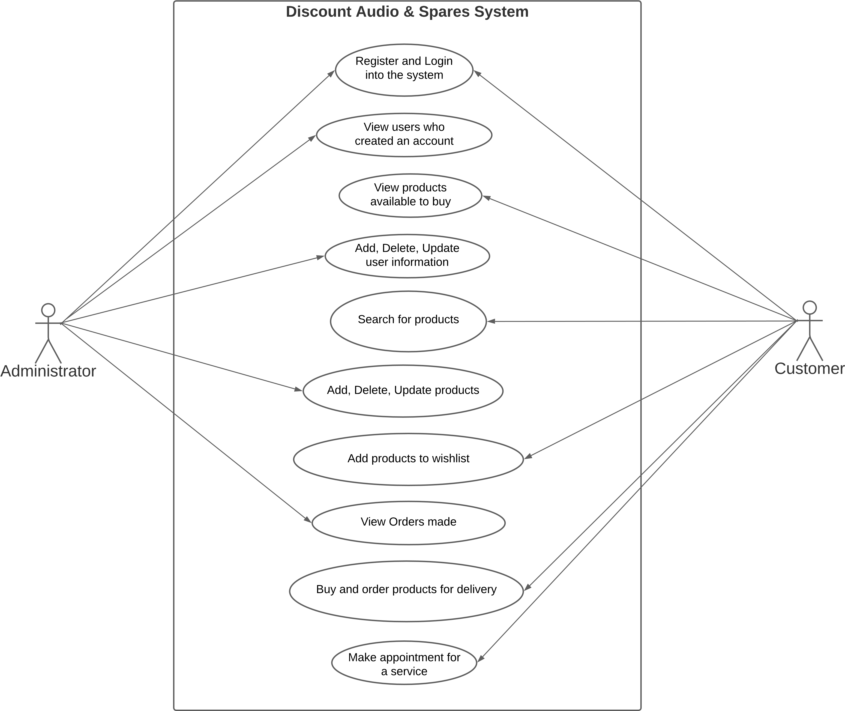
Solution Domain

Slide 6
Project Scope
The mobile application and website must be done within 12-16 weeks.

Slide 7
Major Deliverables
1. The customer should be able to book vehicle service and buy various vehicle spare parts on both the website and mobile application.
2. The app should send message notifications on discounts available. The app should work online and work without errors. This should help improve company production and sales.
3. A fully functional mobile app and website

Slide 8
Milestones Schedule
Milestone | Completion Date
Baseline project plan prepared | August 12, 2022
Functional requirements determined | August 19, 2022
Mobile app and website’s architecture and database designed | September 20, 2022
Database developed | September 23, 2022
Code for website developed | October 21, 2022
Code for mobile application developed | October 24, 2022
Website tested | November 11, 2022
Mobile application tested | November 15, 2022
Prototype presented and demonstrated | November 18, 2022
Final project presented and demonstrated | November 21, 2022
Both software reviewed | Final Week

Slide 9
THANK YOU

Slide 10
Major Risks
Risk Area | Occurrence H/L/M | Impact H/L/M | Risk Response
System could crash due to high traffic of customers | Low | High | Increase database capacity
Loss of customer data or information | Medium | Medium | Backup customer data and information in cloud storage
Project completion delayed | Low | Medium | Organize days when the team works overtime to make up for the delayed days.

